Slide 1
18PYB103J
SEMICONDUCTOR PHYSICS
UNIT 5
Principle of Electron Microscopy
Scanning electron Microscopy
Transmission Electron Microscopy
Atomic Force Microscopy
Lecture 13, 14

Slide 2
OPTICAL VS ELECTRON MICROSCOPY
OPTICAL
Visible light
Glass lens
Air medium
Resolving power in the range of micrometre
ELECTRON
Electron beam
Magnetic lens
Vacuum medium
Resolving power in the range of nanometre

Slide 3
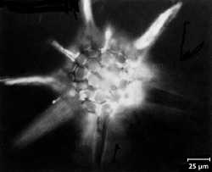
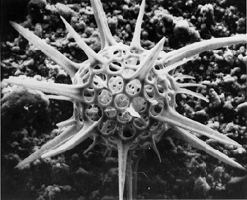
Optical Microscopy vs Scanning Electron Microscopy
25μm
radiolarian
OM
SEM
Small depth of field
Low resolution
Large depth of field
High resolution
http://www.mse.iastate.edu/microscopy/

Slide 4
Types of Electron Microscope
SEM
TEM
AFM
STM
SPM
SPL
SIMS(Secondary ion mass spectrometry)
FIB(Focused ion beam)

Slide 5
Principle of SEM:
Electron beam scan over the surface of the film.
Principle of TEM:
Electron beam passes through the thin sample.

Slide 6
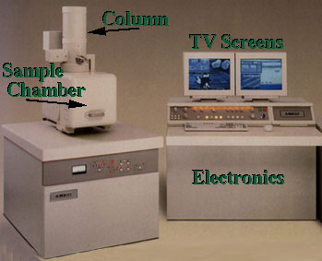
What is SEM?
Column
TV Screens
Sample
Chamber
The SEM is designed for direct studying of the surfaces of solid objects
Scanning electron microscope (SEM) is a microscope that uses electrons rather than light to form an image. There are many advantages to using the SEM instead of a OM.
Notes:
http://www.mse.iastate.edu/microscopy/

Slide 7
Topography
The surface features of an object or "how it looks", its texture; direct relation between these features and materials properties (hardness, reflectivity...etc.)
Morphology
The shape and size of the particles making up the object; direct relation between these structures and materials properties (ductility, strength, reactivity...etc.)
Composition
The elements and compounds that the object is composed of and the relative amounts of them; direct relationship between composition and materials properties (melting point, reactivity, hardness...etc.)
Crystallographic Information. How the atoms are arranged in the object; direct relation between these arrangements and materials properties (conductivity, electrical properties, strength...etc.)

Slide 8
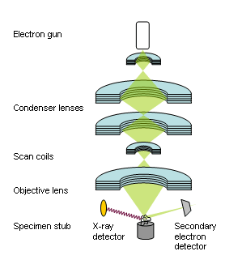
Working concept of SEM

Slide 9
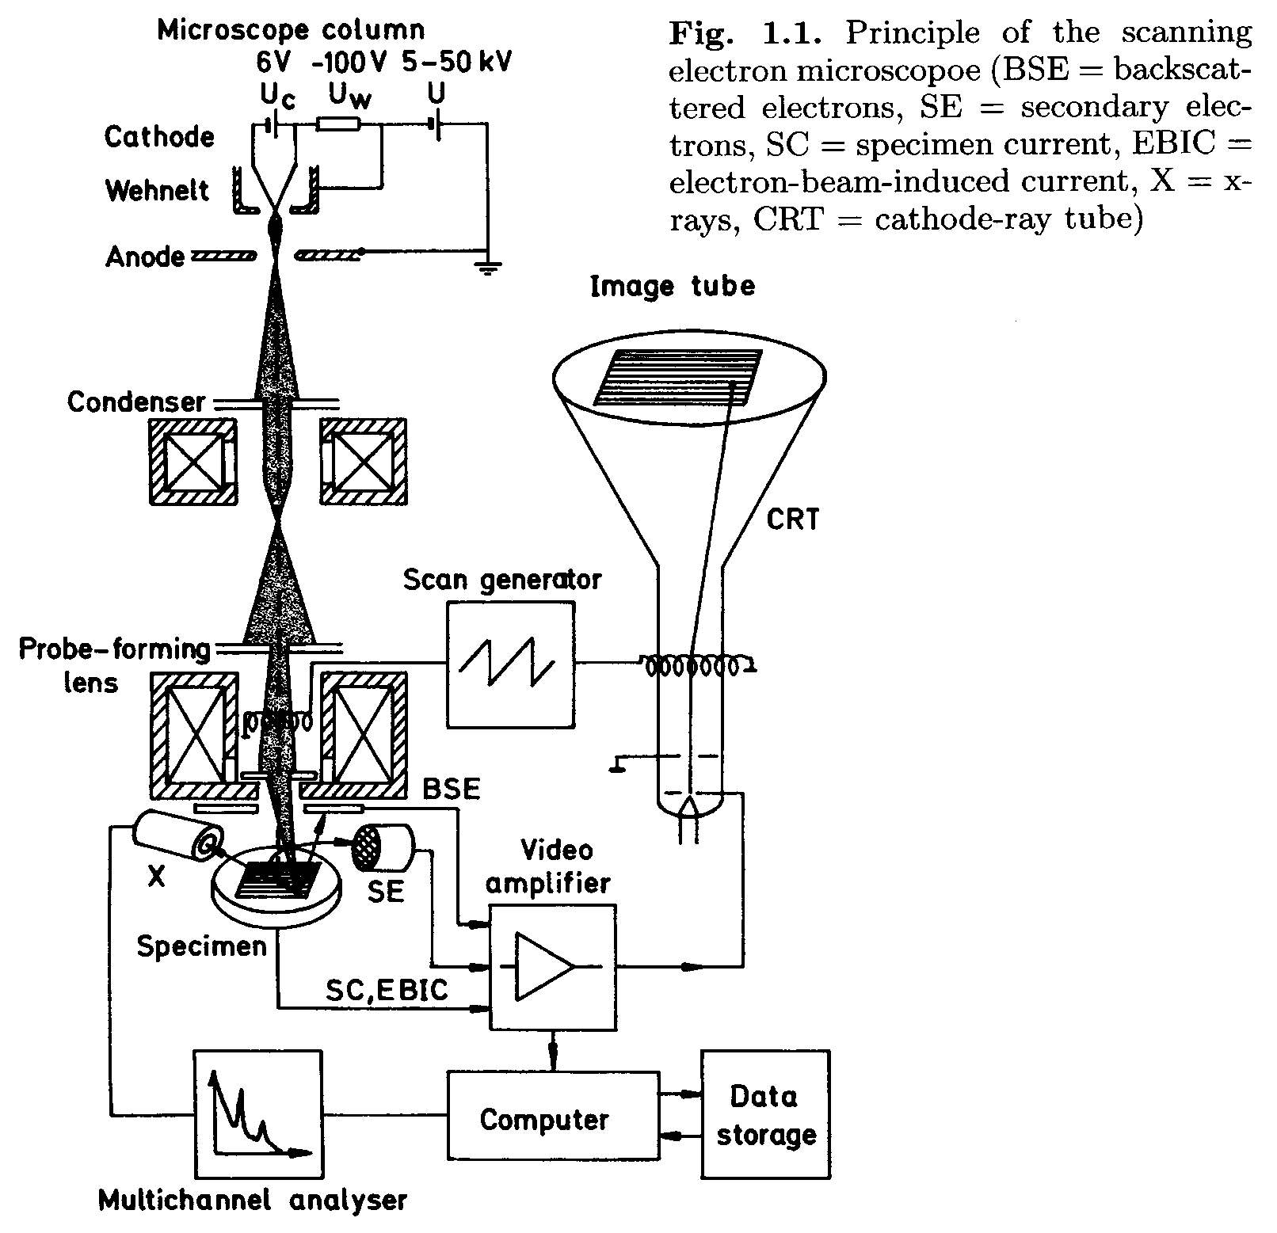
A more detailed look inside
Electron Gun
e⁻ beam
α
Source: L. Reimer, “Scanning Electron Microscope”, 2nd Ed., Springer-Verlag, 1998, p.2

Slide 10
How an Electron Beam is Produced?
Electron guns are used to produce a fine, controlled beam of electrons which are then focused at the specimen surface.
The electron guns may either be thermionic gun or field-emission gun.
Hair pin filament made ofa tungsten wire of 100µm is used to generate electron.

Slide 11
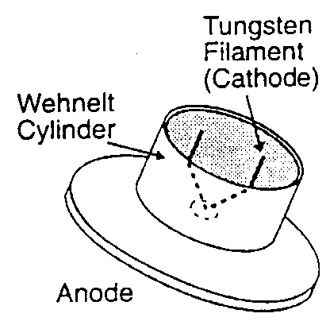
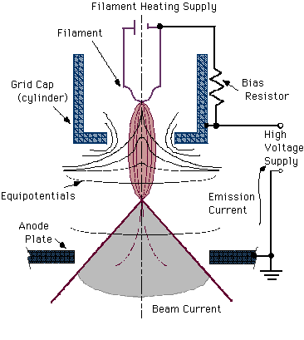
Thermionic Emission Gun
A tungsten filament heated by DC to approximately 2700K or LaB₆ rod heated to around 2000K
A vacuum of 10⁻³ Pa (10⁻⁴ Pa for LaB₆) is needed to prevent oxidation of the filament
Electrons “boil off” from the tip of the filament
Electrons are accelerated by an acceleration voltage of 1-50kV
-
+

Slide 12
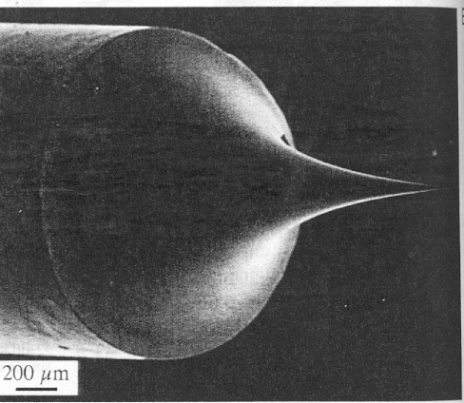
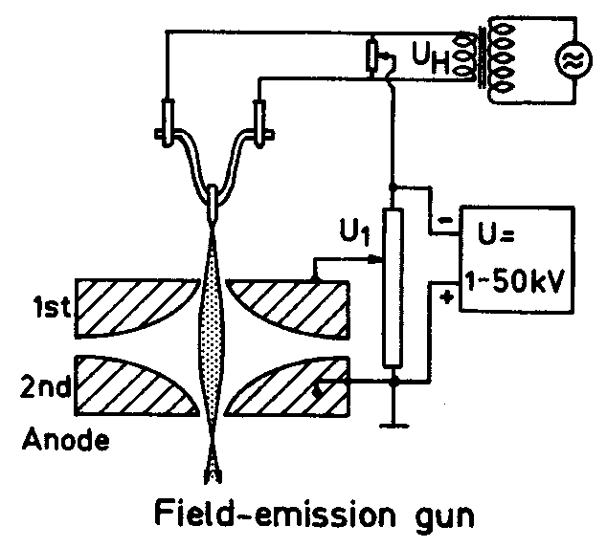
Field Emission Gun
The tip of a tungsten needle is made very sharp (radius < 0.1 μm)
The electric field at the tip is very strong (> 10⁷ V/cm) due to the sharp point effect
Electrons are pulled out from the tip by the strong electric field
Ultra-high vacuum (better than 10⁻⁶ Pa) is needed to avoid ion bombardment to the tip from the residual gas.
Electron probe diameter < 1 nm is possible
Notes:
1st anode to regulate the field strength at the tip by U₁ and hence regulate the emission current. 2nd anode: accelerates the electrons to the final kinetic energy.

Slide 13
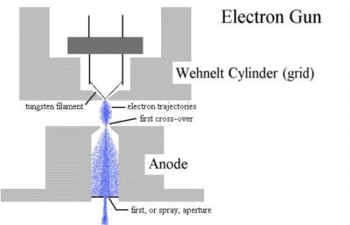
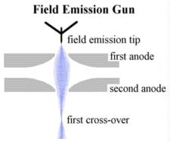
Source of Electrons
Thermionic Gun
E: >10MV/cm
T: ~1500ºC
W
Filament
(5-50μm)
(5nm)
W and LaB₆ Cold- and thermal FEG
Electron Gun Properties
Source Brightness Stability(%) Size Energy spread Vacuum
W 3X10⁵ ~1 50μm 3.0(eV) 10⁻⁵ (τ )
LaB₆ 3x10⁶ ~2 5μm 1.5 10⁻⁶
C-FEG 10⁹ ~5 5nm 0.3 10⁻¹⁰
T-FEG 10⁹ <1 20nm 0.7 10⁻⁹
Brightness – beam current density per unit solid angle
Notes:
Ideally the field emission tip is used in a vacuum of 10nPa or better. Even in that condition, however, a few gas molecules will still land on the tip from time to time and these will cause fluctuations in the emission current. Eventually the whole tip will be covered and the output will become very unstable. The cathode must then be cleaned by rapidly heating it to a high T (2000C) for a few seconds (Cold FEG). Alternatively the tip can be kept warm (800-1000C, thermal FEG), in which case the majority of impinging molecules are immediately reevaporated. In this case acceptably stable emission is maintained even in a vacuum of 100 nPa or so.

Slide 14
Magnetic Lenses
Condenser lens – focusing
determines the beam current which impinges on the sample.
Objective lens – final probe forming
determines the final spot size of the electron beam, i.e., the resolution of a SEM.

Slide 15
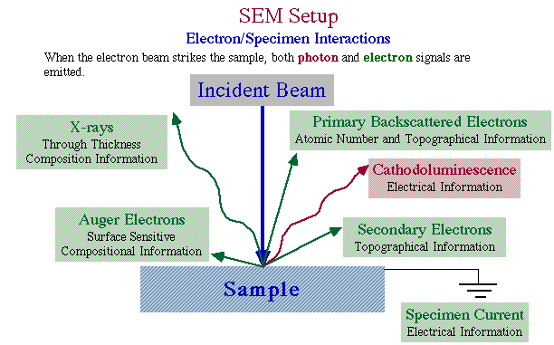
Electron Beam and Specimen Interactions
Sources of Image Information
Electron/Specimen Interactions
(1-50KeV)
Electron Beam Induced Current (EBIC)
Notes:
Specimen interaction is what makes Electron Microscopy possible. Elastic and inelastic scattering are the elementary atomic interaction processes, though the final signal used for image formation is, with only a few exceptions, not the result of single scattering processes but of the complete electron diffusion caused by the gradual loss of the electron energy and by lateral spreading caused by multiple elastic large-angle scattering.
All signals come from different depth of sample. Right:mainly imaging and left: chemical
Cathodoluminescence (CL)-The emission of ultraviolet, visible or infrared light stimulated by electron bombardment. A great many substances, especially semiconductors and minerals show CL. CL contains much analytical information and can reveal material differences that cannot be detected by other methods, e.g., dopants distribution (information is only qualitative). However, CL is frequently used in combination with EBIC and the recombination of charge carries at lattice defects also allows lattice defects to be imaged.
EBIC-Inelastic scattering in semiconductors results in the generation of electron-hole pairs, and a few thousands of electron-hole pairs are created per incident electron. In the depletion layer of a p-n junction, the strong electric field separates the charge carries and minority carries can hence reach the junction by diffusion. This results in a charge-collection current or electron-beam-induced-current, which can be amplified and used in a quantitative manner to measure the width of the junction and its depth below the surface, the diffusion length and the surface recombination rate of minority carries.
The largest fraction of the primary electron energy that is lost during the cascade of inelastic scattering processes is converted into phonons or heat.

Slide 16
Electron Beam and Specimen
Interactions
AUGER ELECTRON:
Auger electrons are reflected from top most layer of the surface.
SECONDARY ELECTRON:
Secondary electrons are ejected from k orbital of the specimen of atom by inelastic scattering interaction with beam of electron.
BACKSCATTERED ELECTRON:
These electron are higher energy electron that are reflected or backscattered out of the specimen by elastic scattering interaction with beam of electron

Slide 17
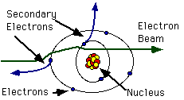
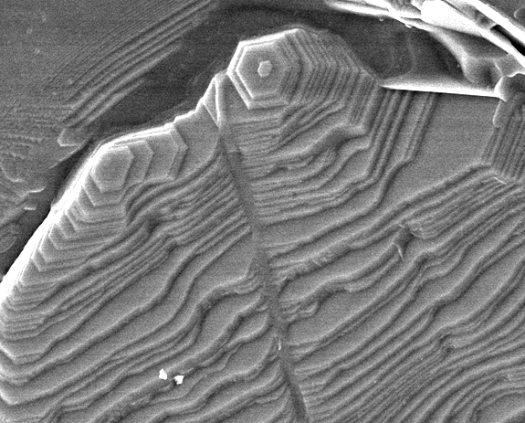
Secondary Electrons (SE)
Primary
BaTiO₃
Production of SE is very topography related. Due to their low energy, only SE that are very near the surface (<10nm) can exit the sample and be examined (small escape depth).
Growthstep
5μm
SE image
Notes:
The interaction of the beam electron with the solid can lead to the ejection of loosely bound electrons of the conduction band in metals or the valence band in insulators and semiconductors. This interaction results in the transfer of only a few electron volts of energy to the band electron and causes a slight energy loss and path change in the incident electron. Each incident electron can produce several secondary electrons.
Arbitrairly, such emergent electrons with energies less than 50 eV are called secondary electrons. 90% of secondary electrons have energies less than 10 eV; most from 2 to 5
There is a great difference between the amount of energy contained by beam electrons compared to the specimen electrons and because of this, only a small amount of kinetic energy can be transferred to the secondary electrons.

Slide 18
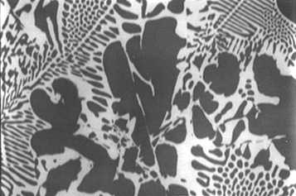
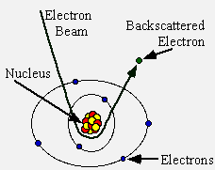
Backscattered Electrons (BSE)
Primary
BSE are produced by elastic interactions of beam electrons with nuclei of atoms in the specimen and they have high energy and large escape depth.
BSE image from flat surface of an Al (Z=13) and Cu (Z=29) alloy
Notes:
As the name implies, elastic scattering results in little or no change in energy of the scattered electron, although there is a change in momentum. Since momentum, p=mv, and m doesn't change, the direction of the velocity vector must change. The angle of scattering can range from 0-180 degrees. Elastic scattering occurs between the negative electron and the positive nucleus. Sometimes the angle is such that the electron comes back out of the sample. These are backscattered electrons.

Slide 19
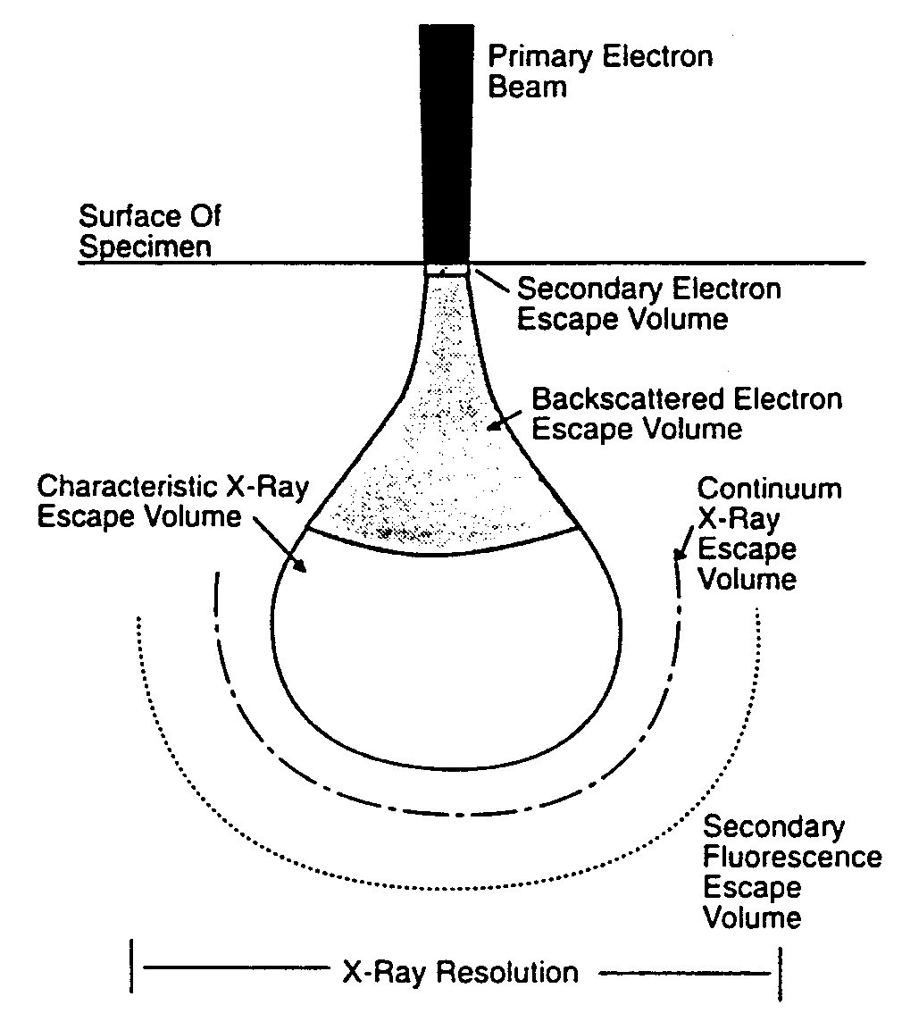
Escape Volumes of Various Signals
If the diameter of primary electron beam is ~5nm
- Dimensions of escape zone
Secondary electron:
diameter~10nm; depth~10nm
Backscattered electron:
diameter~1μm; depth~1μm
X-ray: from the whole
interaction volume, i.e., ~5μm
in diameter and depth
Notes:
This escape volume limits the resolution in images produced with BSE and x-ray (element mapping) to a value that is of the order of size of the escape volume, regardless of how small the actual diameter of the incident electron beam may be.

Slide 20
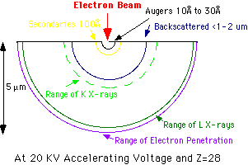
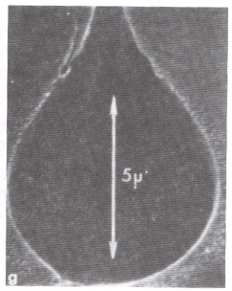
Electron Interaction Volume
Pear shape
5μm
a
b
a.Schematic illustration of electron beam interaction in Ni
b.Electron interaction volume in polymethylmethacrylate
(plastic-a low Z matrix) is indirectly revealed by etching
Notes:
Interaction volume will determine resolution of EDS in SEM and will be discussed more
Later. Keep in mind interaction volume inversely proportional to atomic number, Z.
Electrons can penetrate into sample and the higher the energy, the deeper range the electrons can penetrate. Beam-sample interaction volume is proportional to the electron energy. On the other hand, the x-ray generation range depends on critical ionization energy of elements, E_{c}. E_{c}-K line >> E_{c}-L line. Electrons lose their energy due to multiple inelastic scattering while they are penetrating the sample. That is why the x-ray generation range of K line is smaller than that of L line, since the former needs higher energy to be excited, whereas the energy of electrons become smaller and smaller as they penetrate deeper and deeper into the sample.

Slide 21
Main Applications
Topography
  The surface features of an object and its texture (hardness, reflectivity… etc.)
Morphology
  The shape and size of the particles making up the object (strength, defects in IC and chips...etc.)
Composition
  The elements and compounds that the object is composed of and the relative amounts of them (melting point, reactivity, hardness...etc.)
Crystallographic Information
  How the grains are arranged in the object (conductivity, electrical properties, strength...etc.)

Slide 22
Sample preparation technique in TEM
Mechanical polishing
Chemical etching
Sample Staining
Ion etching
An inert gas passed through an electric field to generate a plasma stream that is directed to sample surface.
Tissue Sectioning:
Tissue sample need to be coated with a thin layer of conducting material.

Slide 23
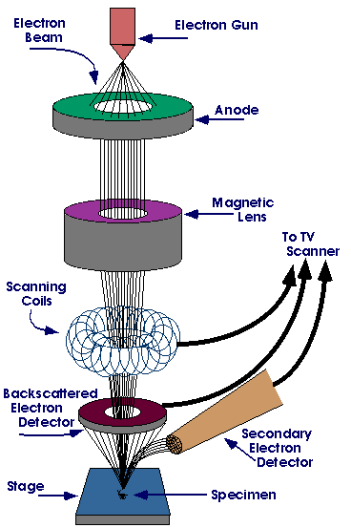
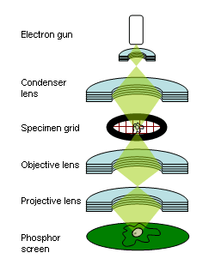
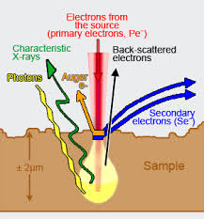
Working concept of TEM

Slide 24
Comparison of SEM &TEM
SEM
Electron beam scan over the surface
Sample preparation is easy
Image show on CRT
Resolution is 2nm
TEM
Electron beam passes through the thin sample.
Sample preparation is very difficult.
Image show on fluorescent screen
Resolution is 0.2nm

Slide 25
Scanning Probe Microscopes (SPMs)
Two types of microscopy
  Scanning Tunneling Microscope (STM)
  Atomic Force Microscope (AFM)

Slide 26
Atomic Force Microscopy

Slide 27
Definition of AFM
The atomic force microscope (AFM) is a very high-resolution type of scanning probe microscopy.
Resolution is fractions of a nanometer.
The AFM is one of the foremost tools for imaging, measuring and manipulating matter at the nanoscale.
The information is gathered by "feeling" the surface with a mechanical probe.

Slide 28
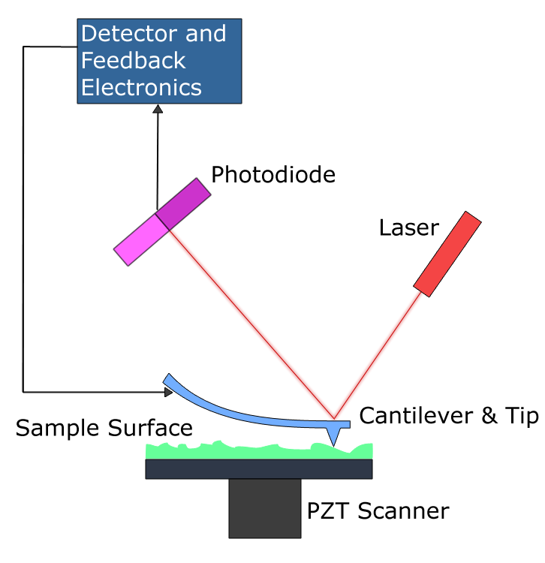

Slide 29
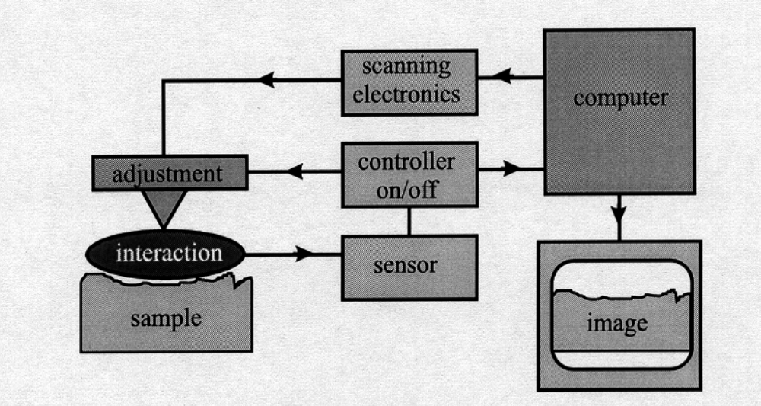
Basic Arrangement & Alignment of AFM

Slide 30
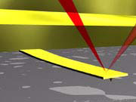
The laser spot is focussed on the back of the cantilever and the angle of the reflected laser is detected by a PSD (photosensitive detector)

Slide 31
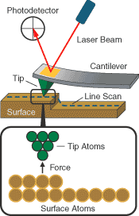
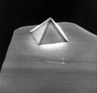
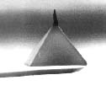
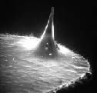
How It Works
Invented in 1986
Cantilever
Tip
Surface
Laser
Multi-segment photodetector
Figure 4. Three common types of AFM tip. (a) normal tip (3 µm tall); (b) supertip; (c) Ultralever (also 3 µm tall). Electron micrographs by Jean-Paul Revel, Caltech. Tips from Park Scientific Instruments; supertip made by Jean-Paul Revel.
http://stm2.nrl.navy.mil/how-afm/how-afm.html#imaging%20modes
http://www.molec.com/what_is_afm.html

Slide 32
AFM consist of micro scale cantilever with a sharp tip and its end scan that is used to scan the specimen surface .
The cantilever is made up of silicon or silicon nitride with a tip radius of curvature on the order of nanometre.

Slide 33
Scanning Modes:
1.) Tapping/Contact Mode
2.) Non contact Mode

Slide 34
Non-Contact Mode
Measures attractive forces between tip and sample
Tip doesn’t touch sample
Van der Waals forces between tip and sample detected
Problems: Can’t use with samples in fluid
Used to analyze semiconductors
Doesn’t degrade or interfere with sample- better for soft samples

Slide 35
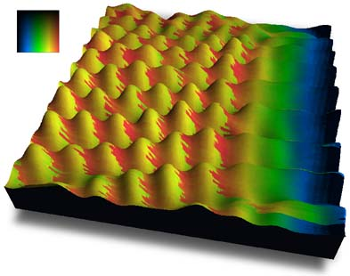
Topography
Contact Mode
  High resolution
  Damage to sample
  Can measure frictional forces
Non-Contact Mode
  Lower resolution
  No damage to sample
Tapping Mode
  Better resolution
  Minimal damage to sample

Slide 36
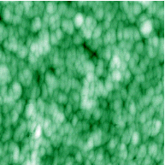
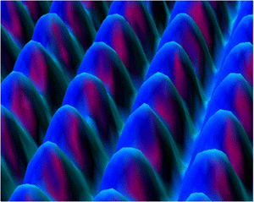
Nickel from an STM
ZnO from an AFM
Sources: http://www.almaden.ibm.com/vis/stm/blue.html
http://www.asylumresearch.com/ImageGallery/Mat/Mat.shtml#M7

Slide 37
Applications
Study Unfolding Of Proteins
Imagining Of Biomolecules
Force Measurements In Real Solvent Environments
Antibody-Antigen Binding Studies
Ligand-Receptor Binding Studies
Binding Forces Of Complimentary DNA Strands
Study Surface Frictional Forces
Ion Channel Localization
Notes:
Mechanical Unfolding - Measure the response of folded proteins to mechanical stress
Topology
Interaction of domains
Stiffness-Elasticity studies
Muscle proteins fold and unfold in the presence of Ca2+

Slide 38
Various Application of AFM:
1.) Beam Deflection
Detection
2.) Force Spectroscopy
3.) Nanolithography

Slide 39

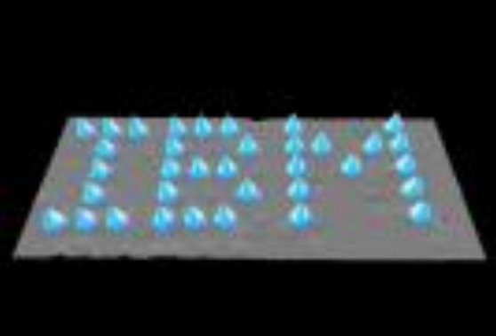
Using AFMs in Nanoscience
  Allows atom by atom (or clumps of atoms by clumps of atoms) manipulation as shown by the images below
Xenon atoms
Carbon monoxide molecules
Source: http://www.almaden.ibm.com/vis/stm/atomo.html

Slide 40
ADVANTAGES OF AFM
The AFM has several advantages over the scanning electron microscope (SEM). Unlike the electron microscope which provides a two-dimensional projection or a two-dimensional image of a sample, the AFM provides a true three-dimensional surface profile.
Additionally, samples viewed by AFM do not require any special treatments (such as metal/carbon coatings) that would irreversibly change or damage the sample. While an electron microscope needs an expensive vacuum environment for proper operation, most AFM modes can work perfectly well in ambient air or even a liquid environment.

Slide 41
This makes it possible to study biological macromolecules and even living organisms.
In principle, AFM can provide higher resolution than SEM. It has been shown to give true atomic resolution in ultra-high vacuum (UHV) and, more recently, in liquid environments.
High resolution AFM is comparable in resolution to Scanning Tunneling Microscopy and Transmission Electron Microscopy.

Slide 42
DISADVANTAGES OF AFM
A disadvantage of AFM compared with the scanning electron microscope (SEM) is the image size. The SEM can image an area on the order of millimetres by millimetres with a depth of field on the order of millimetres.
The AFM can only image a maximum height on the order of micrometres and a maximum scanning area of around 150 by 150 micrometres.

Slide 43
DISADVANTAGES OF AFM
Another inconvenience is that an incorrect choice of tip for the required resolution can lead to image artifacts.
Traditionally the AFM could not scan images as fast as an SEM, requiring several minutes for a typical scan, while a SEM is capable of scanning at near real-time (although at relatively low quality) after the chamber is evacuated.
The relatively slow rate of scanning during AFM imaging often leads to thermal drift in the image

